Slide 1


Slide 2

01
Enhancing Practice Economics: Driving Revenue Growth in a Changing Healthcare Market
Presented by
Charlotte Flood, CEO, Northwest Primary Care - Moderator
Charles Lathram, Chief Development Officer, Revere Health
Rebecca Birenbaum, CEO, Springfield Clinic

Slide 3

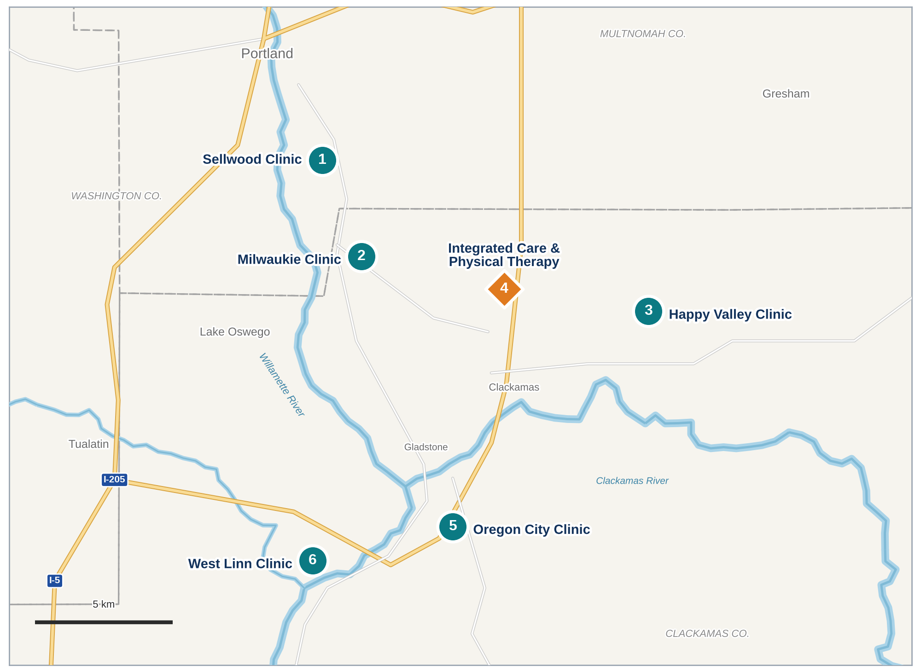

Slide 4


Northwest Primary Care
Independent Primary Care Physician Owned, Single-Specialty
38 Primary Care Providers- 27 MD/DO; 11 APP
Primary Care is our bread and butter
Ancillary is our icing on the cake
Sleep; Physical Therapy; Integrated Care (GLP-1, CCM, VB Care); Mammography, Ultrasound, X-Ray, Full-Service Lab; Audiology
Formed a Clinically Integrated Network with community, independent Primary Care

Slide 5
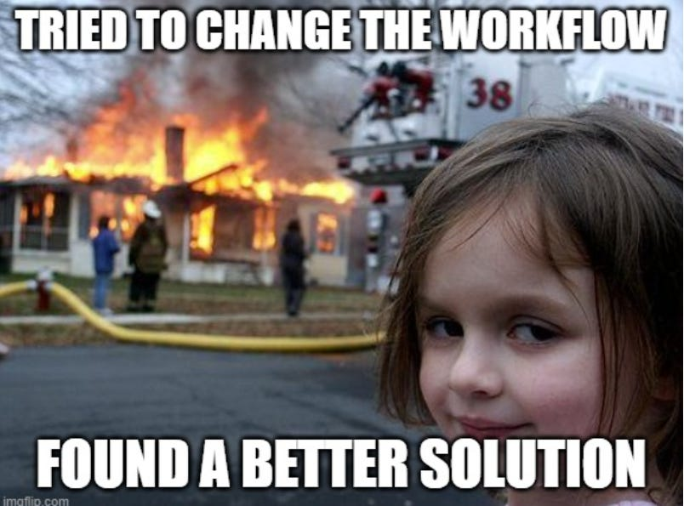
Why Groups are Looking Beyond Traditional Reimbursement?
As you think about the economics of independent practice today, where do you see the greatest opportunity to generate revenue outside of traditional payer contracting?
Rebecca Birenbaum- introduction and answer
Charles Lathram- introduction and answer

Slide 6
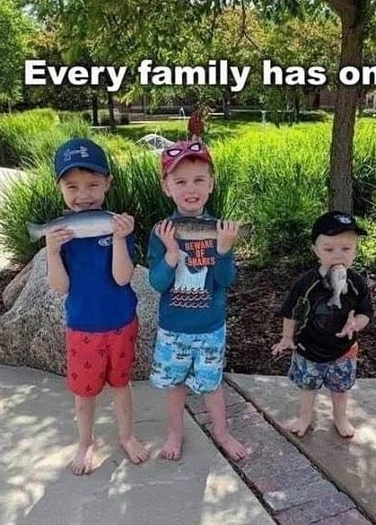
Why Groups are Looking Beyond Traditional Reimbursement?
Going Beyond the Practice: CINs, Employers and New Contracting Models
How to prepare to contract directly with employers
  Infrastructure Requirements
What makes the proposition compelling to self-insured?
Do groups need scale or a CIN/Network to make it work?
How to convince employers to take a chance?
What have you learned?
Charles Lathram
Rebecca Birenbaum

Slide 7
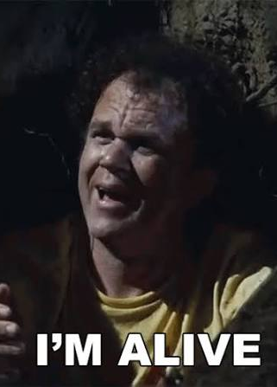
Why Groups are Looking Beyond Traditional Reimbursement?
Building New Revenue Streams Within the Practice
What services have actually moved the needle?
How do you determine what makes sense?
Population Health as a Revenue Strategy
Any tries and fails? Nice to share what NOT to do
Charles Lathram
Rebecca Birenbaum

Slide 8



CONCEPT
Build, don't cut: margin comes from new revenue, not from a smaller expense line
THE PREMISE
Nobody ever cut their way to independence.
Independent practices survive on what they build. The fastest thing to build is a direct relationship with the people who actually pay the bill.
cut
build
Notes:
Opening answer, about 90 seconds. Don't list service lines. Reframe the question. The greatest opportunity outside payer contracting is not a service. It's a customer.

Slide 9

CONCEPT
Follow the subsidy: what the system overpays to acquire tells you what your practice is worth
They lose $314,000 a doctor. They keep buying.
$314K
Ask why.
Because the money was never in the visit. It lives downstream: imaging, lab, infusion, surgery, the referral itself. The subsidy is what it costs to control that stream.
median annual subsidy per employed physician inside health system medical groups
Imaging
Lab
Infusion
Surgery
Referral
It crossed $300,000 in 2024 and hasn't come back.
You already own it. Innovation is the work of keeping it.
Source: Kaufman Hall Physician Flash Report, Q2 2026
Notes:
This is the Musings argument in one slide. Nobody loses $314,000 a doctor by accident. The system is paying for the downstream. Every idea in the next twenty minutes is a way for an independent group to keep, and get paid fairly for, the thing the system is willing to lose money to acquire. Number is Kaufman Hall, Q2 2026, median investment/subsidy per physician FTE.

Slide 10



CONCEPT
Change the customer: sell to the party that wins when care costs less
One customer. Sixty years. Never once on our side of the table.
The insurance company
The self-insured employer
Makes money when you get paid less
Writes the fee schedule, then hands it to you
Has never met your patients
Makes money when their people are healthy and at work
Wants lower cost, faster access, a doctor who knows names
Can decide in a Tuesday meeting
67%
of covered workers are in a self-funded plan
$26,993
average family premium. They are looking for you.
Source: KFF Employer Health Benefits Survey, 2025
Notes:
For sixty years independent medicine has had one customer, the insurance company, and it has never once been on our side of the table. The self-insured employer is. Two thirds of covered workers are in a plan where the employer is writing the checks, and the family premium is about the price of a new car, every year. Stop asking what to sell. Start asking who to sell it to.

Slide 11

CONCEPT
Staged innovation: sort every idea by the capital, time, and partners it needs
The lineup
Head to the plate looking to hit singles and you'll win the ballgame.
Singles
Doubles
Home runs
Start Monday
This fiscal year
The long game
No capital, no lawyer, no permission
Some capital, some patience, one good partner
Partners, patience, and a lawyer who does this for a living
One employer contract
Your health plan as customer one
The price transparency data
Care management codes
Call coverage on paper
Ambient AI documentation
Preferred network with a Tier 1 price
Subscription primary care
In-office infusion and pharmacy
Patient access automation
Value-based care with a partner
Real estate you own
Clinically integrated network
A shared data layer
Joint ventures
Captive insurance company
Physician-owned MSO
Your own insurance product
Notes:
This is your map. Everything you say for the rest of the hour sorts into one of these three columns. When anyone asks 'can we do this,' answer with the column. Come back to this slide during Q&A.

Slide 12

CONCEPT
Small bets: moves you can make without capital, counsel, or permission
01
Start Monday.
SINGLES
No capital. No lawyer. No permission.
Notes:
Four seconds. Let it sit and move on.

Slide 13




CONCEPT
Direct contracting: a practice and an employer agree on price and access with nobody in the middle
Direct-to-employer is a single, not a home run.
Four things. Only one of them is a contract.
The employer
One page
Your practice
Start with the employer, not the network.
A 15-doctor group can sign a 300-employee manufacturer tomorrow. The network is what you build when you have six of them and you're running out of specialties to send them to.
1
A fee schedule you can explain in a sentence
Not 400 lines. “Tier 1, no surprises.”
2
Access you can actually promise
A same-week visit for the supervisor whose back is out.
3
One throat to choke
A person who answers the HR director's phone. Not a portal.
4
Patience for the fourth conversation
Benefits get decided once a year, and the broker is in the room.
Notes:
Direct-to-employer is a relationship strategy with a contract attached. Don't ask employers to leave their carrier. Ask them to add a tier. Nobody ever got fired for adding a cheaper option. Charlotte asked whether anyone has done this successfully: yes, twice, at two very different sizes. If you're contracting as a network rather than a single group, get antitrust counsel who does this for a living. The federal safety zones were withdrawn in 2023 and nothing replaced them. The rules didn't get looser, they got vaguer.

Slide 14






CONCEPT
Found revenue: money already owed to you for work you already do
Five singles you can hit this quarter
None of these needs a board vote.
1
2
3
4
5
Pull the transparency data
Be your own first customer
Bill the care management codes
Put call coverage on paper
Buy back the slots, then document for the code
Hospitals and payers now publish their prices. Find what local employers pay the system for an MRI. That number is your sales deck.
You already run a health plan. Steer it to your own doctors and measure what happens.
Chronic care, transitional care, principal care. Work you already do and don't bill.
If the hospital needs your specialists at 2 a.m., that's a service. Services have contracts.
Ambient AI returns time to the schedule and captures the language that supports the level you earned.
Notes:
Hand number three to Charlotte on stage. The care management codes are her lane, and giving them to her makes the panel feel like a team. Number five is the AI answer: it isn't technology, it's revenue you were already earning and failing to document.

Slide 15

CONCEPT
Point solutions: solve one problem a quarter. Don't wait for one platform to solve them all
THE MINDSET
Waiting for the all-in-one solution means five years of unsolved problems.
2 years
1 quarter
to choose the platform that promises to do everything
to put one point solution live and find out if it pays
Notes:
This is singles thinking applied to technology. Solve one problem this quarter. Then solve the next one. The groups that wait for the perfect platform are the ones that get acquired while they're still in the demo.

Slide 16
CONCEPT
Planned bets: one budget cycle, one partner, a return you can measure
02
This fiscal year.
DOUBLES
Some capital. Some patience. One good partner.
Notes:
Four seconds.

Slide 17




CONCEPT
Site-neutral pricing: the same service at the same price, wherever it's delivered
Same idea. More horsepower.
Revere Preferred: a preferred network that offers self-insured employers a Tier 1 price. Launching January 2027.
A Tier 1 price
One number the HR director can repeat to the CFO.
Site-neutral isn't a policy debate for us.
It's the pitch.
Nobody at a hospital system can make this offer. Their pharmacy is a profit center. Their facility fee is a profit center. Their model needs the employer to pay more.
Our pharmacy, a transparent PBM
We can talk about the drug spend, not just the office visit.
In-office infusion
Same drug, same chair, a fraction of the hospital outpatient price.
Notes:
Keep the benefits administrator unnamed: 'a Utah benefits administrator built on reference-based pricing' is the ceiling. No percentage of Medicare on stage. Tier 1 is as specific as it gets. Different size, different state, same customer.

Slide 18


CONCEPT
Access as the product: what employers and patients buy is speed to a clinician, not the visit itself
Access is the product.
The visit is just how we deliver it.
300K
50%
24/7
Where the robots froze
inbound calls a month
never needed
a human
scheduling the system can't match
We tested for eight months with clinicians posing as patients.
Single-specialty calls: fine.
The patient with three conditions and four doctors: frozen solid.
So we are building the handoff before we buy the hype.
Subscription primary care sells the same thing.
A membership to a doctor who answers. Package it where people already stand in line, including the retail pharmacy counter.
Notes:
Sixty seconds, no vendor names. This is an access story, not a cost story. When you sell to an employer you are selling a same-week appointment. Every multispecialty administrator in the room has lived the multi-system patient problem, which is why the failure is the part they'll remember. Direct primary care is phase two of the employer offer.

Slide 19


CONCEPT
Own the upside: take the risk you already manage and the assets you already pay for
Two doubles hiding in plain sight
Get paid for outcomes you already produce
Your landlord should be you
Value-based care with an enablement partner.
They bring capital, analytics, and actuaries. You keep governance.
Care gaps show up at the point of care, in real time, not in a report six months later.
Independent groups are the low-cost setting. Shared savings pays you for being what you already are.
Real estate in separate physician-owned entities.
Rent you were going to pay anyway becomes equity.
A second way for a young physician to own something.
An asset no one can take from you with a salary guarantee.
Notes:
Keep the enablement partner unnamed. No real estate figures. The point on value-based care: you don't have to build the actuarial department. Rent it. The point on real estate: ownership is the retention strategy. People don't walk away from things they own.

Slide 20
CONCEPT
Structural bets: shared ownership, shared governance, years instead of quarters
03
The long game.
HOME RUNS
Partners, patience, and a lawyer who does this for a living.
Notes:
Four seconds. Then straight into the proof of concept.

Slide 21

CONCEPT
Customer zero: prove the offer on your own health plan before you sell it to anyone else
PROOF OF CONCEPT
We were our own first customer.
A mid-size independent group. A hospital system on every corner.
200
800
0
1
Built a physician-funded, physician-governed CIN.
No hospital sponsor. One front door.
providers
employees
hospital partners
2
Moved all 800 of our own people into a self-funded plan backed by a captive.
If you want to know whether your value proposition to employers is real, sell it to your own CFO first.
The scary part. Also the part that worked.
3
Took the same offer to the employers down the street.
Notes:
Tell this as 'a group I led before Revere.' No group name, no city. Conventional wisdom said a group our size couldn't form a network without a hospital partner. So we formed one without a hospital partner. Then we did the thing that scared everybody. Proof it works at mid-size. Charlotte is funding her own CIN, so connect to her here.

Slide 22



CONCEPT
Commitment before structure: get the number, the name, and the date in writing before anyone drafts bylaws
THE HONEST PART
The one that failed first.
A number. A name. A date.
It didn't fail on antitrust, or the doctors, or the money. Everyone loved the idea of a network. Nobody would be first to say what they'd put in and who they'd put in charge.
Enthusiasm is free. Commitment is what you're negotiating for.
Notes:
Your most valuable story. Rooms remember scar tissue, not trophy cases. Keep the earlier effort anonymous and undated. Keep the current partner groups unnamed: 'a handful of independent practices' is the ceiling. Second time around we ran the process backwards: every partner answered in writing what they wanted before any term sheet, and we put our own positions on paper first.

Slide 23



CONCEPT
Data before governance: integration is a shared view of the patient. The org chart comes later
A network without shared data is a newsletter.
What you start with
What you build
What you get
A handful of independent practices. Different EMRs. Different billing systems. No common platform.
One data layer on top of all of it. Nobody rips out their EMR. Everybody sees the same patient.
Point-of-care insight, shared contracts, shared services. Which is an MSO. You didn't plan one. You grew one.
On AI governance: curb the enthusiasm without destroying it. Build the sandbox. Don't lock the door.
Notes:
This is the answer to 'what infrastructure does a CIN actually need' that nobody else on the panel can give. The MSO is the evolution, not a separate strategy. No vendor names, no stack details. If anyone asks about AI risk: physician excitement runs ahead of governance, PHI wanders into public tools, and the executive's job is to build the sandbox.

Slide 24




CONCEPT
Shared ownership: your patients and physicians, an operator's expertise, one cap table
Partner with people who do it for a living.
You bring the patients and the physicians. They bring the operating playbook. You both own it.
Dialysis
Skilled nursing
Surgery and imaging
Your nephrologists already round there. Now they own part of the building they walk into.
Post-acute is where value-based contracts are won or lost. Own a seat at that table.
The downstream the system pays $314,000 a doctor to capture. Keep it in the family.
Three rules: own a real share, hold a board seat, and keep clinical governance with your physicians. If you can't get all three, it isn't a joint venture. It's a lease.
Notes:
No operator names, no ownership percentages. This is the point from the prep call: what do you do well today, and who does the thing next to it better than you ever will? Partner with them. Rebecca's rural outreach arrangements are the same instinct from the other direction, so give her the assist.

Slide 25
CONCEPT
Risk ownership: keep the premium, the data, and the profit inside a company you own
The captive: a cost center becomes a company.
Malpractice used to be a bill. Now it's a balance sheet.
Premium you were paying anyway
Now it stays inside a company your physicians own.
One premium dollar. Multiple coverage lines.
Six years of claims, modeled for root cause
Risk profiles feed the rates. The safest doctors see it in the price.
Malpractice: today
$1
Licensed for more than malpractice
The next line of business
The structure allows other lines of business. Malpractice is where it starts, not where it stops.
And the one after that
Not there yet. Built for it.
Notes:
No captive financials. Do not mention a prepaid tail; the captive no longer offers it. The story now: premium you were paying anyway stays in a company the physicians own, six years of claims data drives the rates, and the structure allows other lines of business. The aspiration, stated as an aspiration: one day, one premium dollar pays for multiple coverage lines. Don't name which lines are under study. Needs some size and a lot of nerve, but it was first done by groups smaller than most in this room.

Slide 26






CONCEPT
The pipeline: always have the next three ideas on the board
WHAT WE'RE EXPLORING NEXT
The whiteboard
A physician-owned MSO
Near-site employer clinics
Subscription care at the pharmacy counter
Shared services for the five-doctor practice that refuses to sell.
One clinic, three employers, none big enough to do it alone.
Sell access where people already stand in line.
Rural specialty outreach
A buy-in ladder
A seat at the statehouse
Your specialists, their hospital, one day a week.
If ownership only works for people who already have money, the system buys the ones who don't.
Site-neutral payment and ownership transparency are revenue strategy.
A new one most weeks in The Independence Playbook at independentdoc.org
Notes:
This is your answer to Charlotte's closing questions: what are groups underestimating, and what are you exploring next. Pick two, not six. The buy-in ladder is the succession answer. The statehouse tile is the legislative liaison talking: policy is a revenue line if you show up.

Slide 27
CONCEPT
Replicability: most of this needs nerve before it needs size
Scale is helpful. Mindset is required.
What's actually replicable
Any size, starting Monday
Needs scale, partners, or nerve
Direct-to-employer. You can decide faster than I can.
Subscription primary care. Access is the product.
Your own health plan. You already have one employer customer. It's you.
The five singles. All of them.
A captive. Some size and a lot of nerve.
A network. Partners, patience, and a lawyer.
Your own insurance product. Ask Rebecca.
Every one of these was first done by a group smaller than the one you're in.
Notes:
Charlotte's segment four. Short, quotable answers. Where to look first: your own health plan and one employer. What needs scale: fewer things than you think. What's underestimated: the transparency data. Say the singles line once, slowly, and don't explain it.

Slide 28

CONCEPT
Coopetition: independents win as a network. The rival is consolidation, not each other
ONE MORE THING
The practice across the street is not your competition.
The system is.
Share the playbook. Build the network. Refer to each other. Every independent group that makes it makes the next one more likely.
Notes:
Swing hard here. Everyone in this room has spent a career treating the group across town as the enemy while the system bought the town. This room is the network. That's the whole point of being here.

Slide 29


CONCEPT
One next action: strategy is the first phone call
BEFORE YOU LEAVE THIS ROOM
Write one employer's name on your notepad. Call them Monday.
That's the whole strategy.
Charles J. Lathram, III, FACMPE, CCP
The Independence Playbook at independentdoc.org | linkedin.com/in/cjlathramiii
Notes:
Whatever Charlotte's last question is, the final words out of your mouth are this line.

