Slide 1

02
How Independent Groups Compete For Talent – And Keep It
Presented by
Joey Peay, CPA, CEO, Murfreesboro Medical Clinic & Surgicenter - Moderator
David Russo, DO, Columbia Pain Management
Ed Silvey, CEO, The Baton Rouge Clinic
Lindy Williams, Executive Administrator, Boice-Willis Clinic

Slide 2
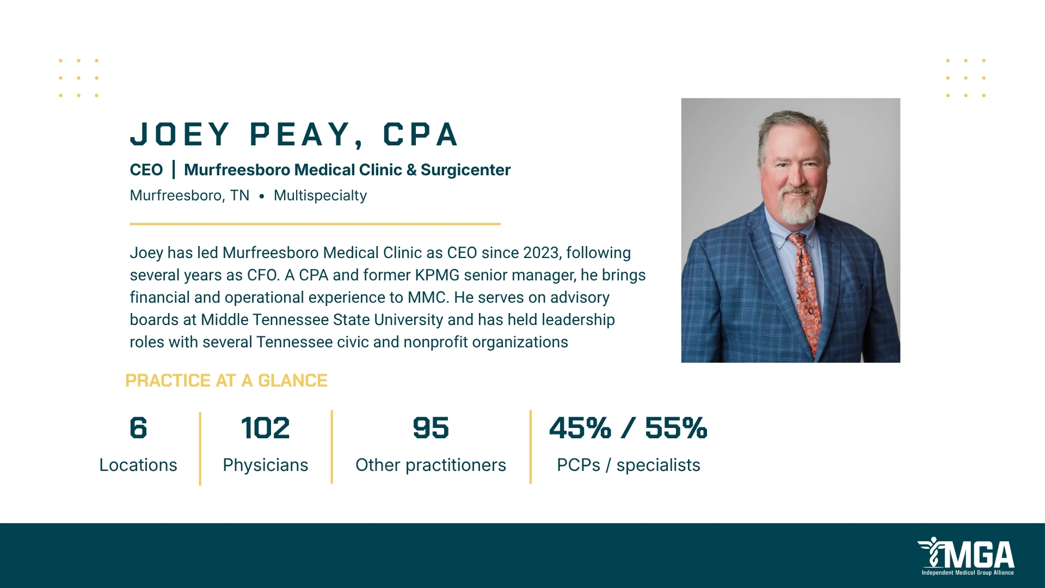

Slide 3
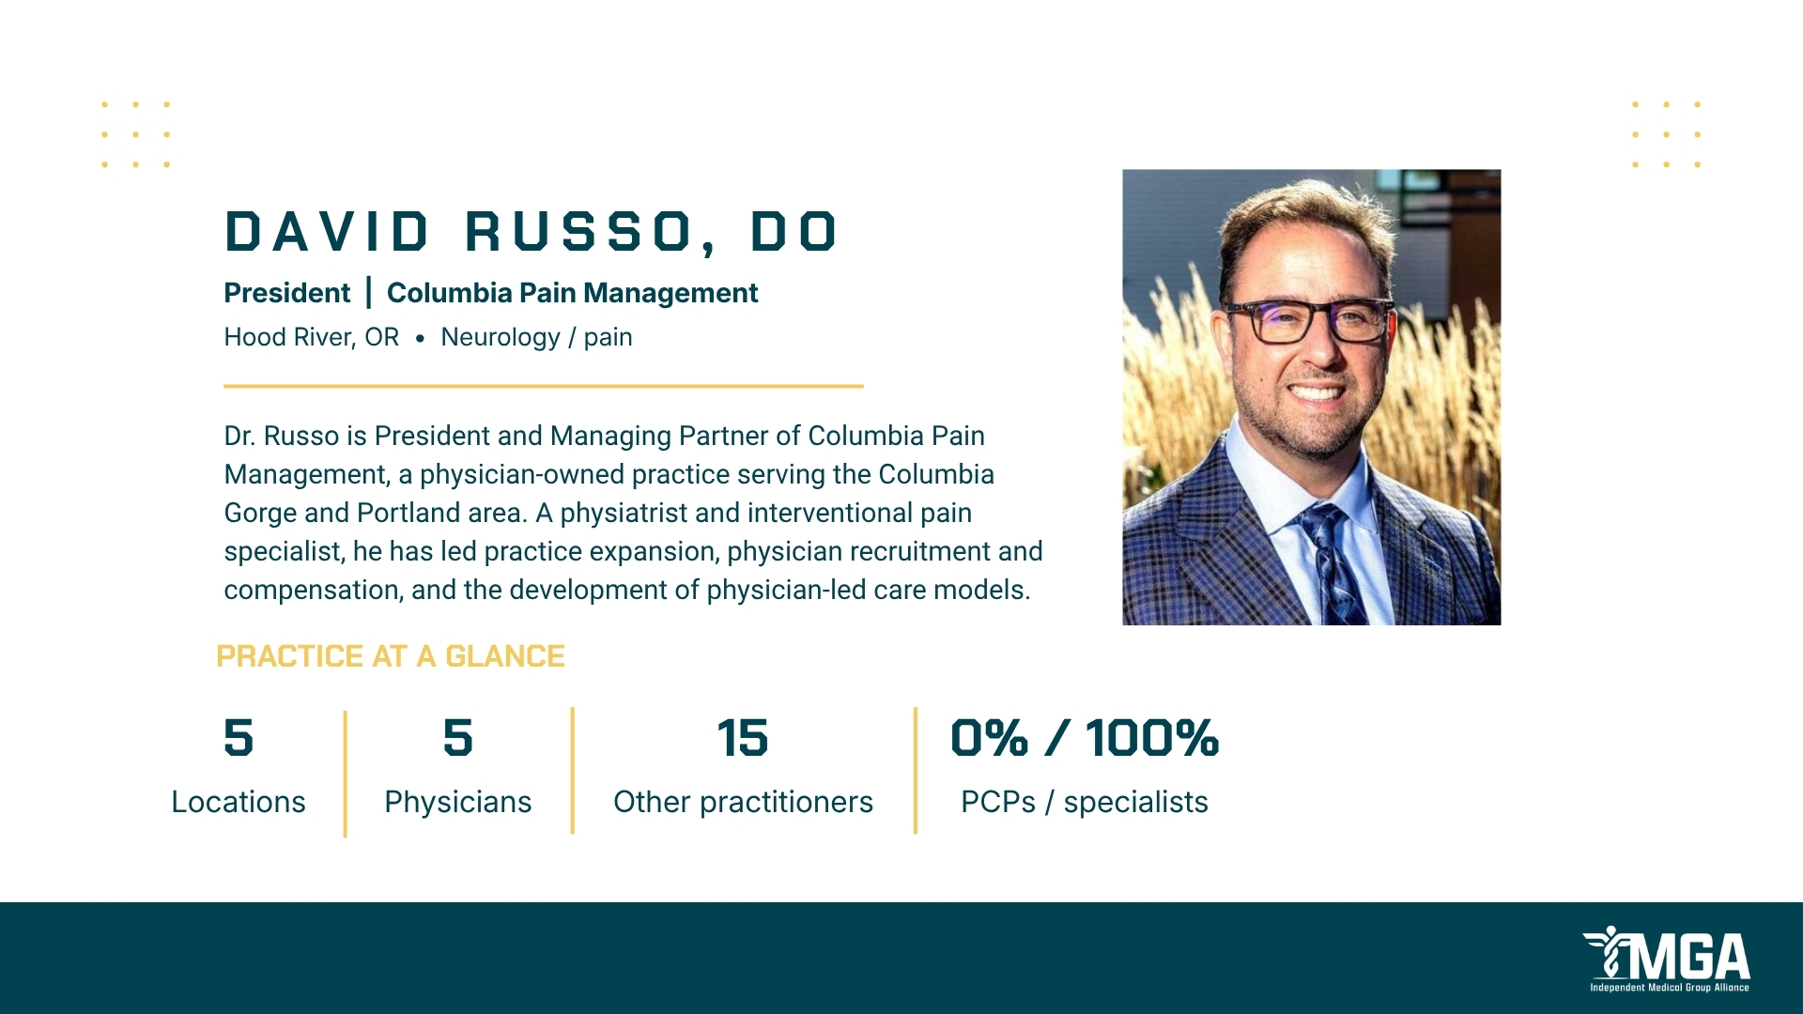

Slide 4
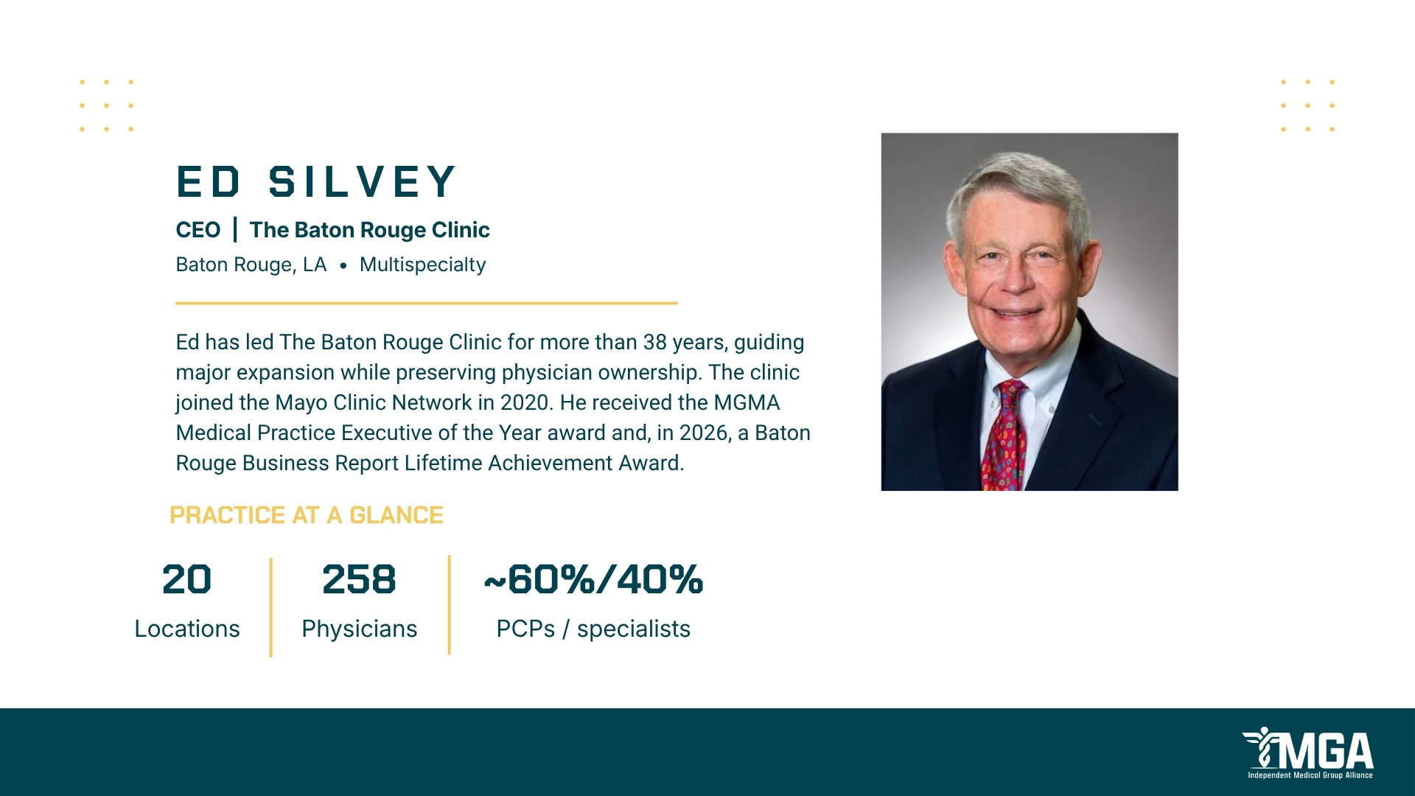

Slide 5
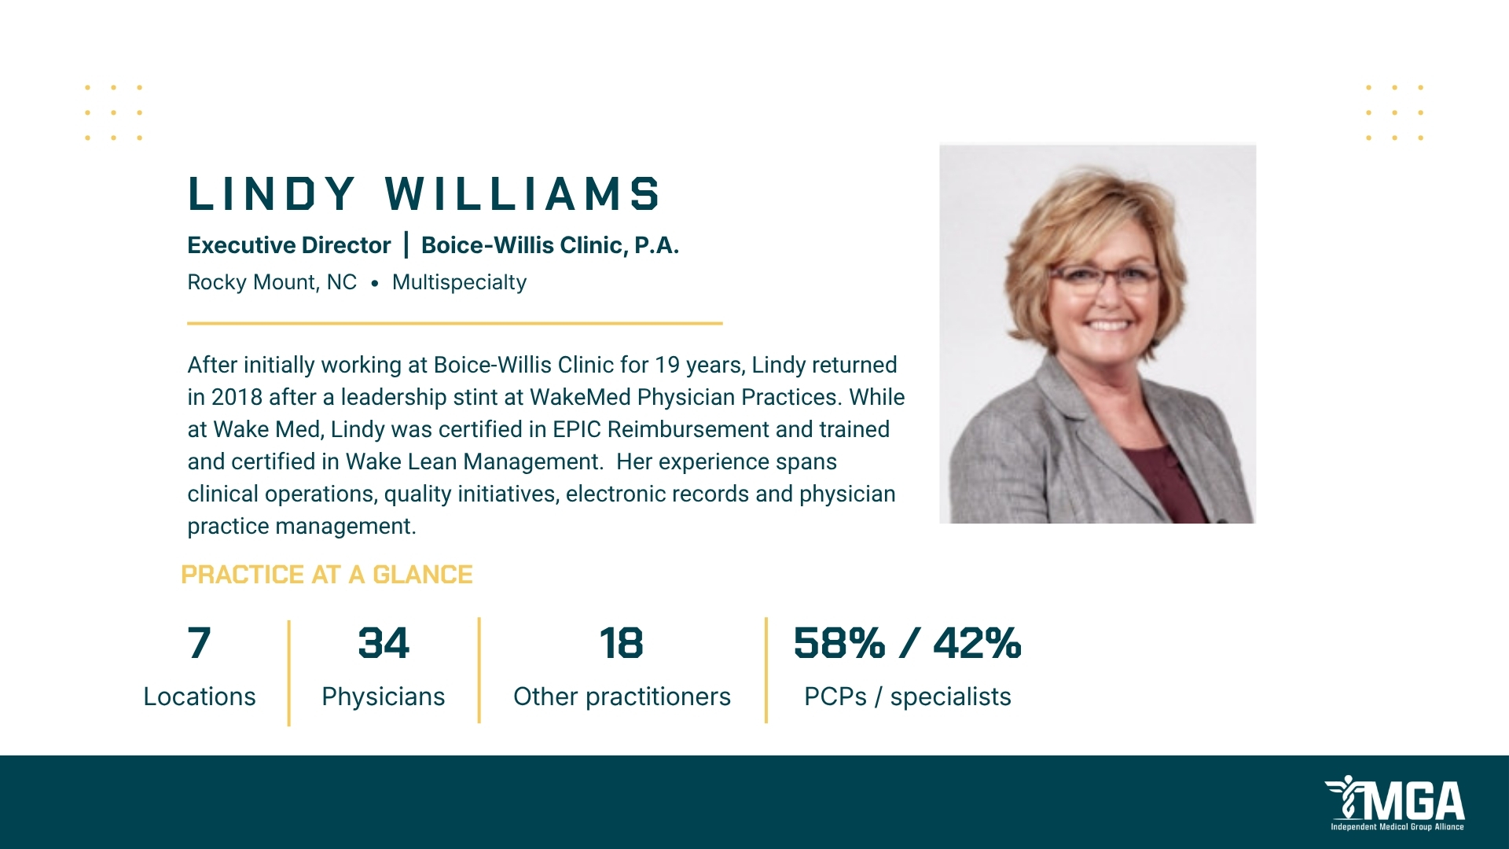

Slide 6
Provider Onboarding

Slide 7
What got us here?

Slide 8
Recognized significant changes
Ways in which new generation interact has changed (emr, social media, texting, doc halo, etc)
Residencies are within hospital systems therefore extremely limited exposure (if any) to private practices
More physicians were out of the hospital therefore no “doctors lounge” to get to know one another
Specific to APP’s
  NP moved quickly from RN training to NP training with little real clinical experience
  Many schools are online with limited true clinical experience
  Frequently asked – what support do we provide to ensure their success

Slide 9
Solution – Provider Onboarding program
Purpose:
  To ensure understanding of the 4 pillars for success
  To introduce and ensure mentoring program is in place and functioning
  To provide 3 levels of onboarding across as 2 year period
  To ensure understanding of private practice

Slide 10
Pillars for success
Quality Care & Patient Experience
Operational Efficiency
Financial Success
Citizenship

Slide 11
Mentoring Program
Each physician is partnered with a mentor in the same specialty and same location
Requires regular touchpoints with mentor
In place for one year
Mentor agreement is required

Slide 12
3 Levels of onboarding
New provider orientation first 2 weeks
  All systems training
  Introductions to staff
  Tours of departments
  Shadowing provider in their areas of specialty
Extended orientation
  15 meetings with Directors and other Subject Matter experts for review of content of Provider Reference Manual
Onboarding meetings
  Associate Physician onboarding – monthly until a full partner
  App – monthly for minimum of one year

Slide 13
Onboarding Meetings
Focus is on:
  Operational data and discussion of barriers and potential resolutions
  Quality data regarding metrics established for their specialty and patient experience reviews
Attendees:
  Executive Physician
  Executive Administrator
  Director of Physician Practices
  Director of Population Health
  Practice Manager
  Other Subject Matter Experts as needed (Coding compliance, Director of Nursing, etc)

Slide 14
Other components
Ramp up
  Associate Physicians:
    No patients for week one
    Prescribed format for schedule with ramp up to full schedule over 3 to 6 months
  APP’s:
    No patients for week one
    Operates as a scribe for their supervising physician week two
    Prescribed format for schedule with ramp up to full schedule over 3 to 6 months
Specific to APP’s
  White paper sessions
  Chart audits for each monthly meeting initially

Slide 15
Lessons and Outcomes
Level of support varies greatly between providers
Allows for identification of barriers earlier in the journey
Promotes teamwork in removing barriers and resolving issues
Supports pillars of success in every discussion

