Slide 1
From AI Overload to AI in Action
Wilmington Health’s journey from searching for the perfect solution to solving real problems

Slide 2
AI Was Everywhere
Operational
Compliance
Legal
Access
Financial
Payers
AI
Analytics
Clinical
Quality
HR

Slide 3
We started looking…
Identify
Define
Explore
Validate
Evaluate
Decide
Identify
Define
Explore
Validate

Slide 4
Then we kept looking…
More products. More possibilities. More decisions
Identify
Define
Explore
Validate
Evaluate
Decide
Identify
Define
Explore
Validate
Evaluate
Decide
Identify
Define
Explore
Validate
Evaluate
Decide
Identify
Define
Explore
Validate
Evaluate
Decide
Identify
Define
Explore
Validate
Evaluate
Decide
Identify
Define
Explore
Validate
Evaluate
Decide
Identify
Define
Explore
Validate
Evaluate
Decide
Identify
Define
Explore
Validate
Evaluate
Decide
Identify
Define
Explore
Validate
Evaluate
Decide

Slide 5
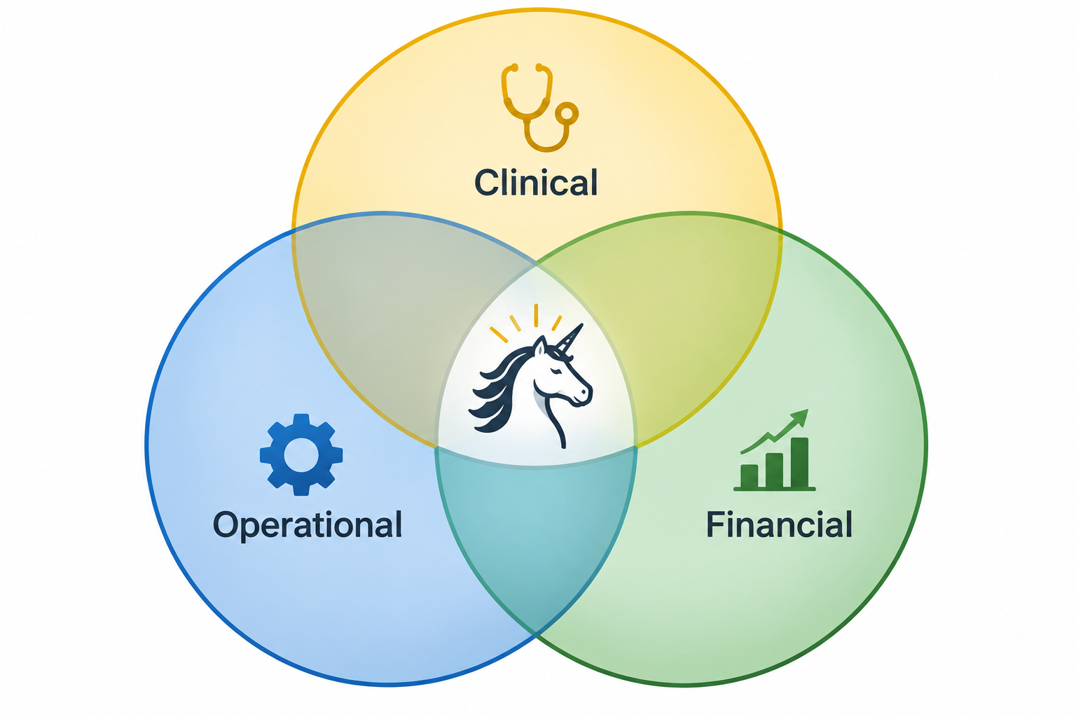
We wanted the Unicorn
One Platform
Every Problem
No Compromises

Slide 6
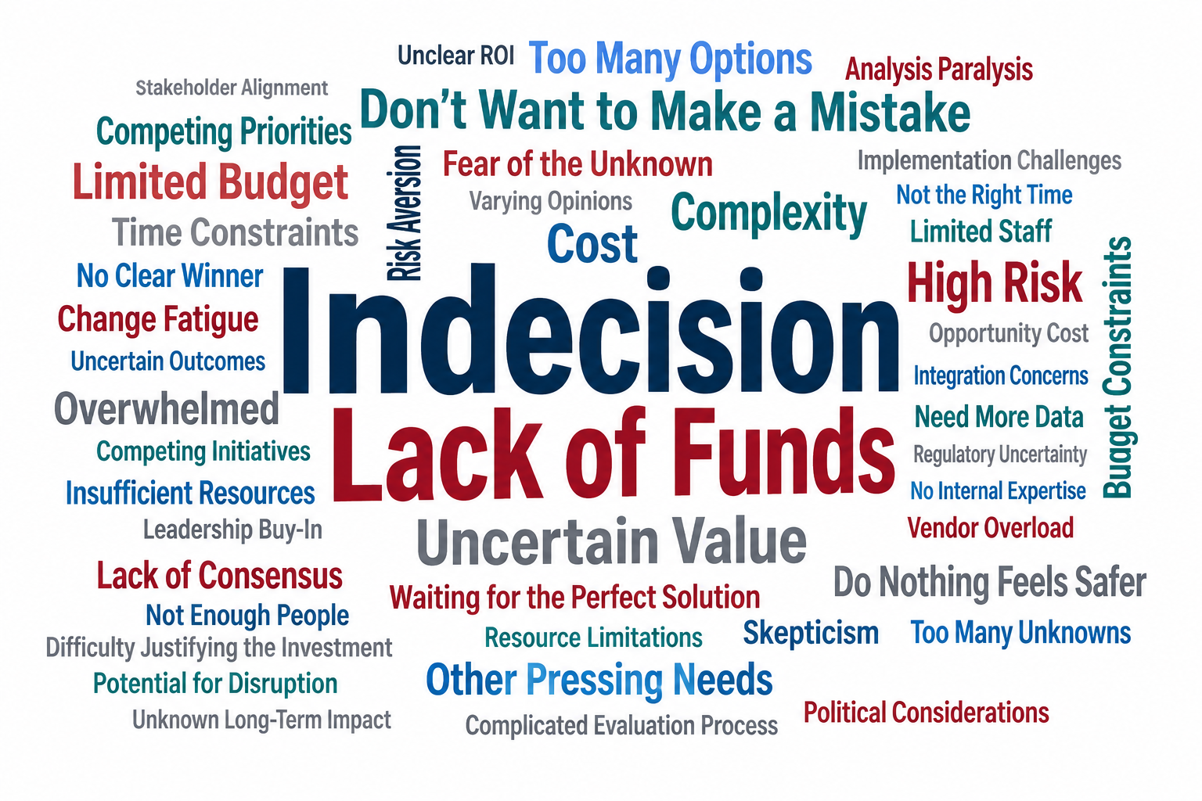
Perfection Became the Enemy of Progress

Slide 7

We Changed the Question
What Problem Are We Trying To Solve?

Slide 8
Where is the Friction?
Time • Repetition • Delay • Cost • Complexity • Errors • Waste • Variability • Frustration • Bottlenecks • Redundancy • Manual Work • Rework • Handoffs • Waiting • Searching • Duplication • Communication • Coordination • Access • Capacity • Staffing • Accuracy • Compliance • Risk • Data Overload • Fragmentation • Inefficiency • Inconsistency • Decision-Making • Prior Authorization • Documentation • Navigation

Slide 9
We Settled on our Strategy
Solved well by the market
BUILD
BUY
Unique to our workflows and data

Slide 10

BUY: Give Providers Time Back
Ambient listening
Clinical Notes

Slide 11

BUY: Answer the Phone
Agentic AI to supplement/replace traditional customer service
Instant inbound call answering
Concurrent call handling
Switchboard-style department routing
FAQs and general practice information
Message capture and escalation
Call summaries

Slide 12
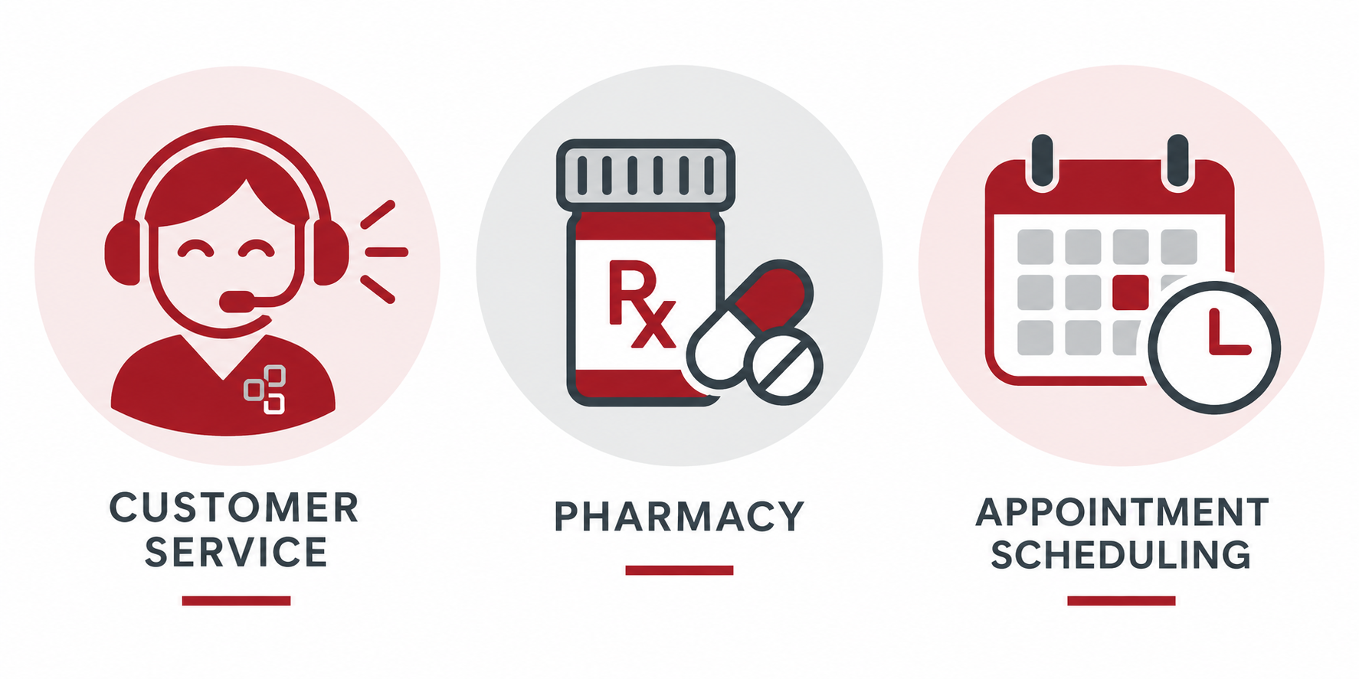
BUY: Answer the Phone-Let the Agent Do More

Slide 13
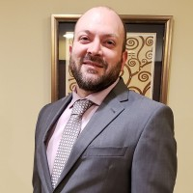
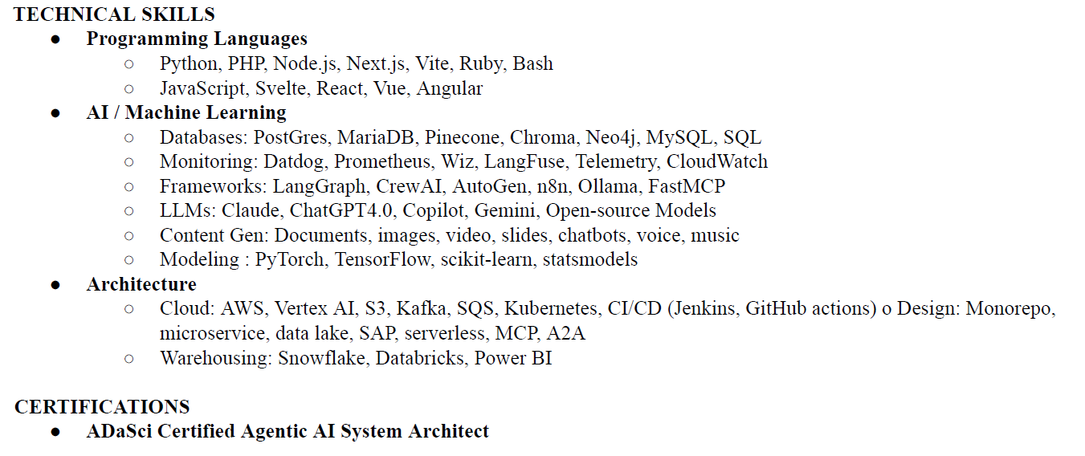
BUILD: Create Our Own Capability
JOE

Slide 14
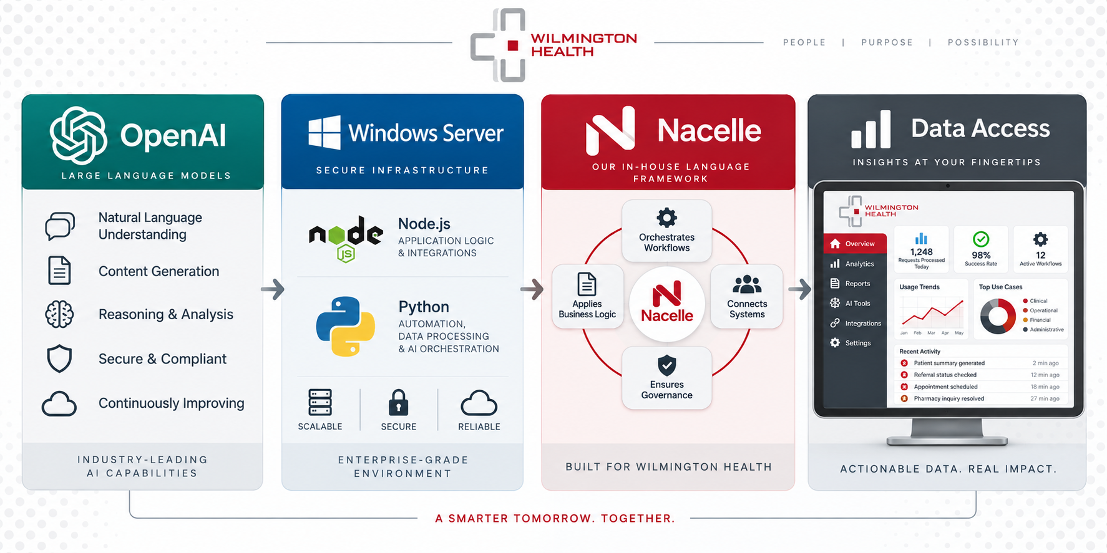
BUILD: The Foundation

Slide 15
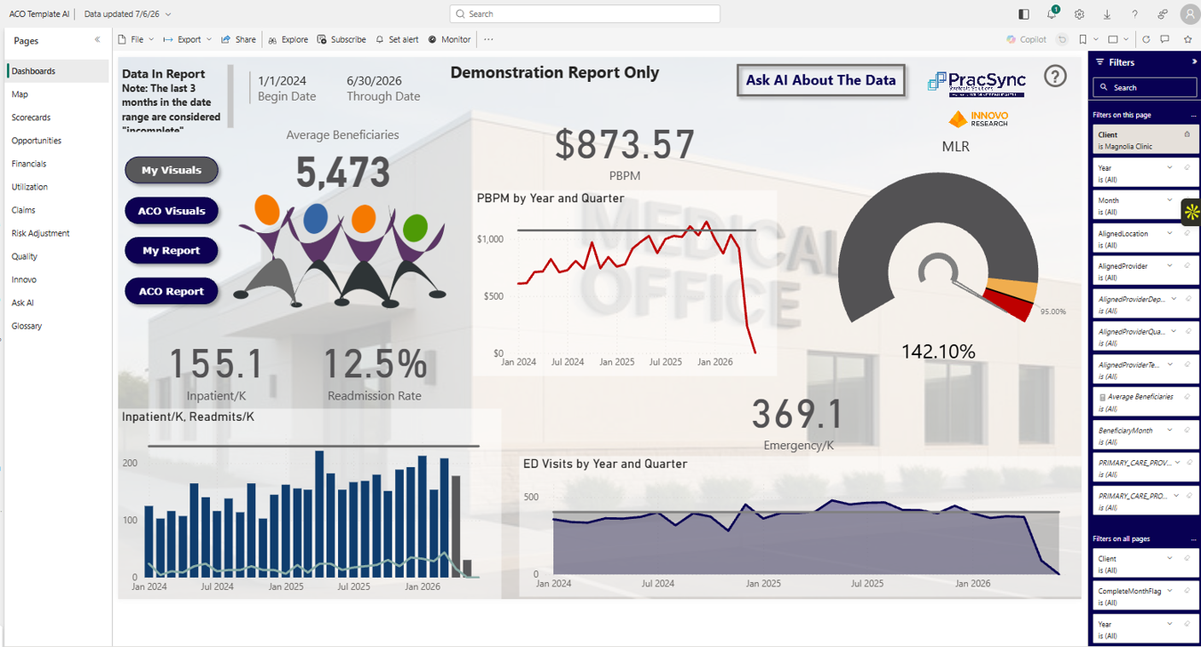
Don’t Just Search the Data. Talk to It.

Slide 16
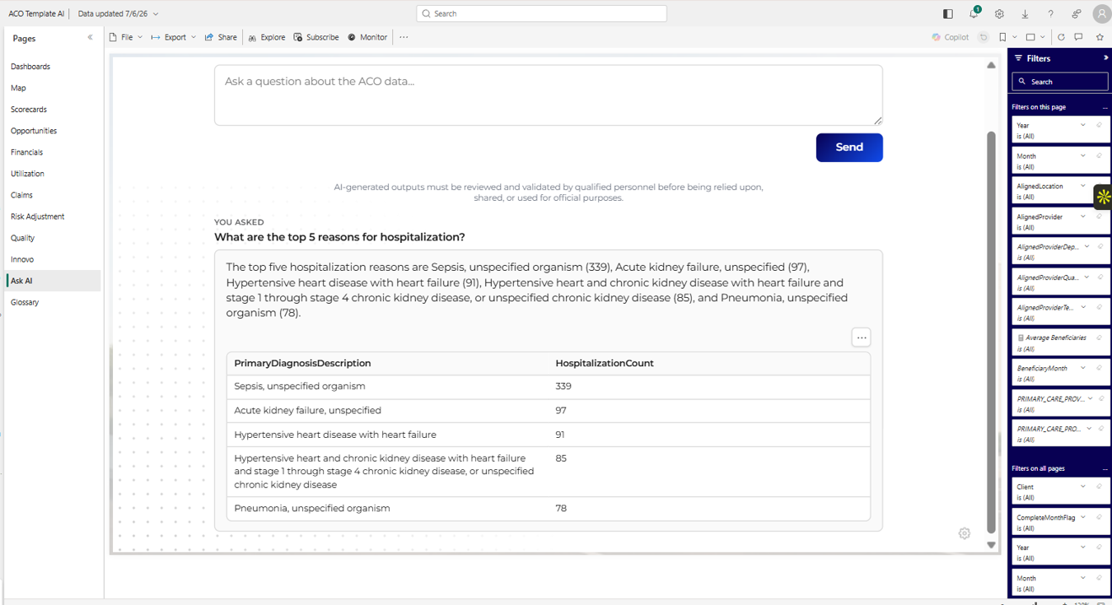
And Refine It.

Slide 17

Build: AI as a Coding CoPilot
HISTORY
PROVIDER
REPORTING
SURFACED
ICD
PROVIDER
REVIEW

Slide 18
Credit for the Care We Provide
Compliance
Clinical Correctness
Proper Reimbursement

Slide 19
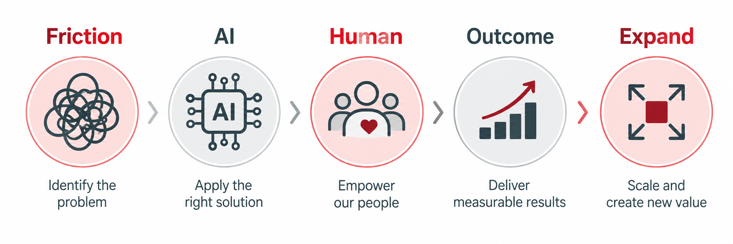
The Pattern Matters More Than the Product

Slide 20



PROGRESS > PERFECTION

