Slide 1

05
AI IN ACTION– Real-World AI. Real Results. Real Competitive Advantage.
Presented by:
Ed Marx, CEO, Marx Advisory - Moderator
Bryan Batson, MD, CEO, Hattiesburg Clinic
Jessica Heestand, MD, Wake Internal Medicine Consultants
Brian Voth, Chief Development Officer, Wilmington Health
Collette Thomas, Director of IT, Murfreesboro Medical Clinic & Surgicenter
Cynthia Lang, CEO, Gastroenterology Associates of the Piedmont
Eric Stecker, MD, Co-founder & Co-Chief Medical Officer, Insight Health

Slide 2


Bryan Batson, MD, CEO, Hattiesburg Clinic

Slide 3


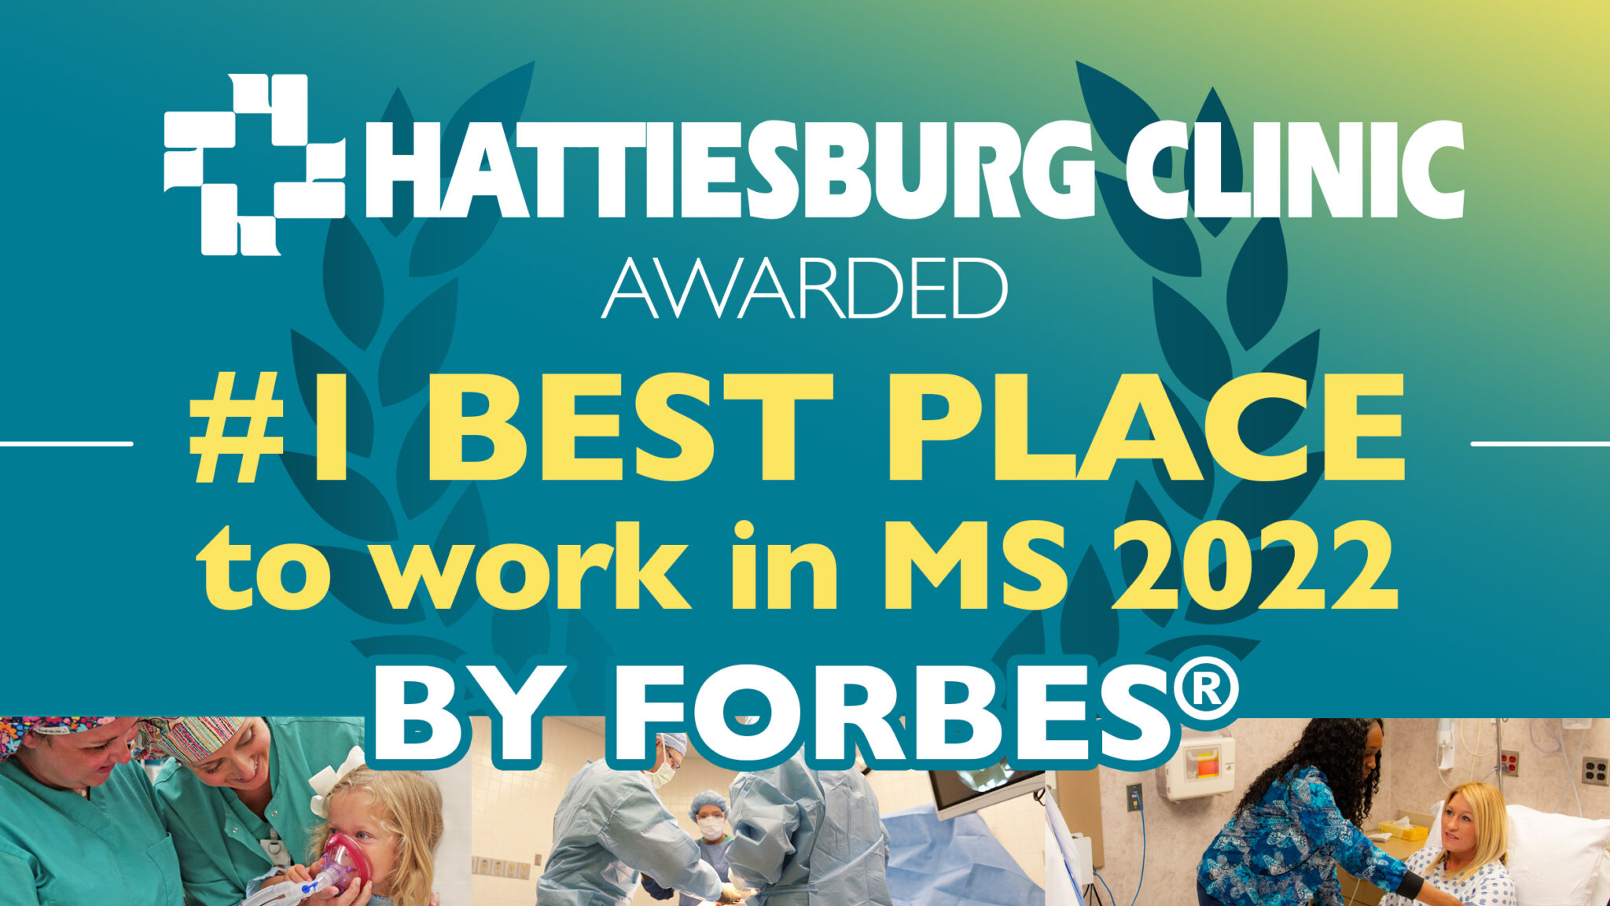
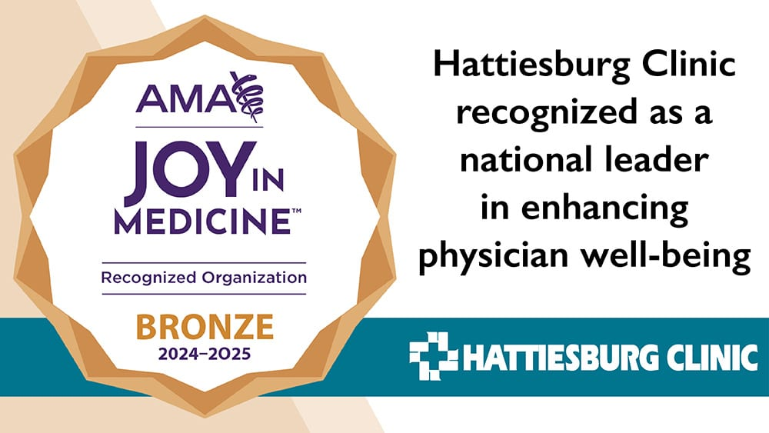
Who we are
Quick Facts:
Shareholders: 28 primary care clinics
Dept of Medicine: 110 5 urgent care clinics
Dept of Primary Care: 108 12 dialysis units
Dept of Surgery: 65 6 ASCs and OBLs
Established in 1963 by 10 local physicians
Now one of the largest independent multi-specialty medical groups in the United States
Over 300 physicians
Over 200 advanced practice providers
Over 40 specialties
Over 2,500 employees
With 74 locations in 17 counties
Market of approximately 800,000 patients
Over 1,000,000 outpatient visits in 2025, excluding dialysis
Over 42,000 outpatient surgeries/procedures in 2025

Slide 4
Organization Approach to AI Adoption
Clinical
Ambient AI
InBasket Management
Summarization Tools
Rev Cycle
Prior Auth Management
LOS & Coding Tools
Medical Necessity Denials
IT/Operations
Data Mining
Dashboard “insights”
Cybersecurity Assistance
Admin
Meetings
Email Management
RHT Grant Applications
Future
We use Epic for our EMR & PMS.
Some of the AI tools we are using are non-Epic.
For today’s presentation, I will not differentiate which AI tools are Epic and which aren’t as my focus is more about AI adoption experiences and strategy than any specific vendor or tool.

Slide 5
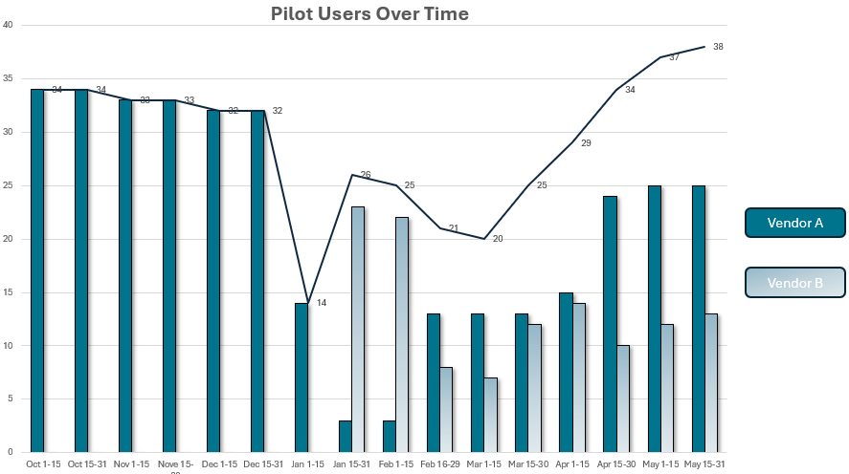
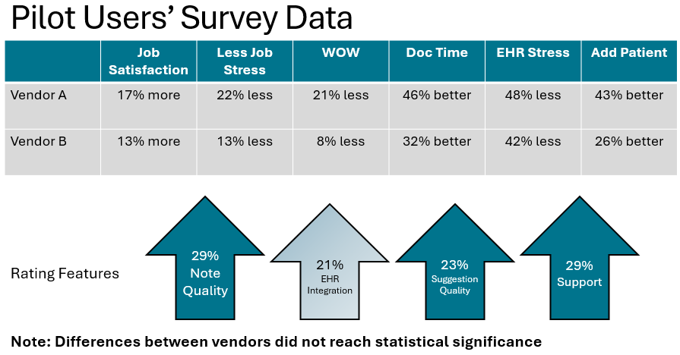
Organization Approach to AI Adoption
Clinical
Ambient AI
InBasket Management
Summarization Tools
Background: In December 2023, after starting with a single Ambient AI tool for 6 months, we moved to a 4-month pilot with 2 vendors and did a forced crossover between the products. Users were then allowed to pick between the two if they wanted to continue to use.

Slide 6
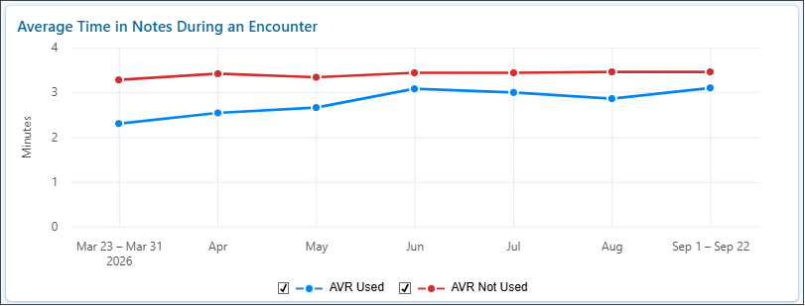
Organization Approach to AI Adoption
Clinical
Ambient AI
InBasket Management
Summarization Tools
Current state:
Over 217K of notes done with Ambient AI
Approximately 50 physicians have chosen to stay with Ambient AI and pay for it
On average, users are completing around 70% of their notes with Ambient AI
Users save on average of 14-19 minutes per day of documentation time
Lessons learned:
Success and satisfaction are highly dependent on putting in time on the front end to “train” the tools
Specialty-dependent success
Challenging for IT team to support 2 different Ambient AI products
Saving ~1 minute per patient adds up quickly over the course of a day, week, month, year…

Slide 7
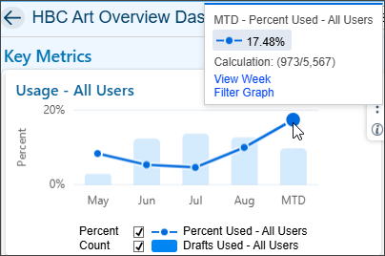
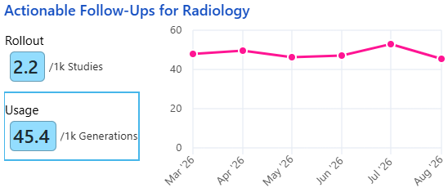
Organization Approach to AI Adoption
Clinical
Ambient AI
InBasket Management
Summarization Tools
Draft replies to Patient Messages:
Pilots started in 2024
Initial feedback was mixed at best
Usage has improved through time but still less than 20% of drafts are accepted “as is”
Draft replies to Test Results:
Pilots started in 2026
Initial feedback similar to those with patient messages
Actionable Follow-ups for Radiology:
Pilots started in 2025 with mammography and CXR
Expanding to renal lesions, pancreatic lesions, and aneurysms

Slide 8

Organization Approach to AI Adoption
Clinical
Ambient AI
InBasket Management
Summarization Tools
Over 91,000 generated since June 2025 pilot
Available to all physicians, but our best use-case has been with the Transitional Care Management and CCM/APCM nurses…
“I have found that using the tool is very helpful when contacting recently discharged patients, particularly because it helps with time management. I can see medication changes without having to review multiple office notes and other documentation to find that information. Using Chart Insights helps me feel more confident in providing appropriate follow-up care.”
“The patient summary saves me valuable time by bringing recent discharges, changes in care, lab results, and other important information together in one convenient view. This allows me, as a case manager, to quickly identify what is most important for each patient and focus on their specific needs for the month. Having this information readily available helps me work more efficiently and focus my time and attention on the areas that are most relevant to the patient’s care.”

Slide 9
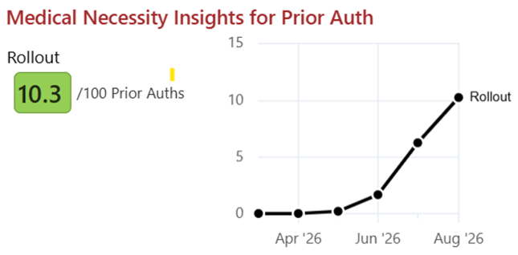
Organization Approach to AI Adoption
With AI-generated prior authorizations, the system analyzes patient data, compares it against specific payers’ policies for the given order, and summarizes evidence to justify medical necessity. The report, which includes citations, can be accepted or modified by PA staff.
Rev Cycle
Prior Auth Management
LOS & Coding Tools
Medical Necessity Denials

Slide 10
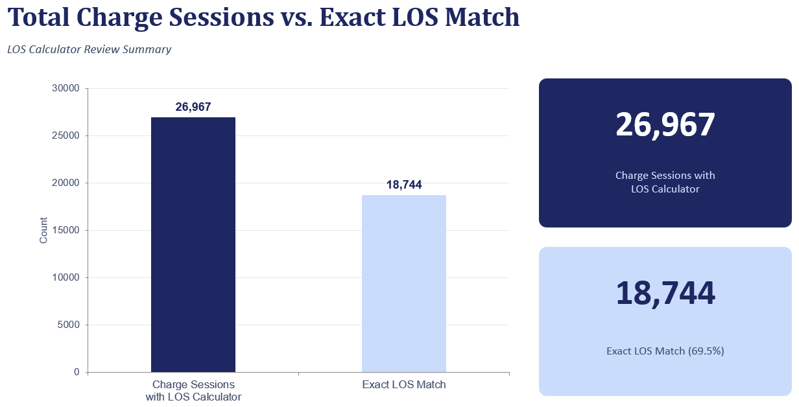
Organization Approach to AI Adoption
Rev Cycle
Prior Auth Management
LOS & Coding Tools
Medical Necessity Denials
1/1/2026-8/31/2026

Slide 11
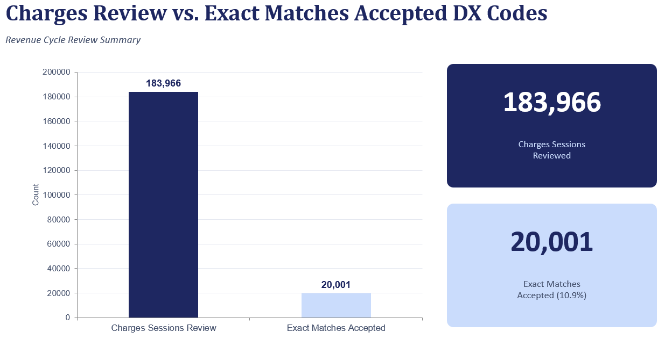
Organization Approach to AI Adoption
Rev Cycle
Prior Auth Management
LOS & Coding Tools
Medical Necessity Denials
1/1/26-8/31/26

Slide 12
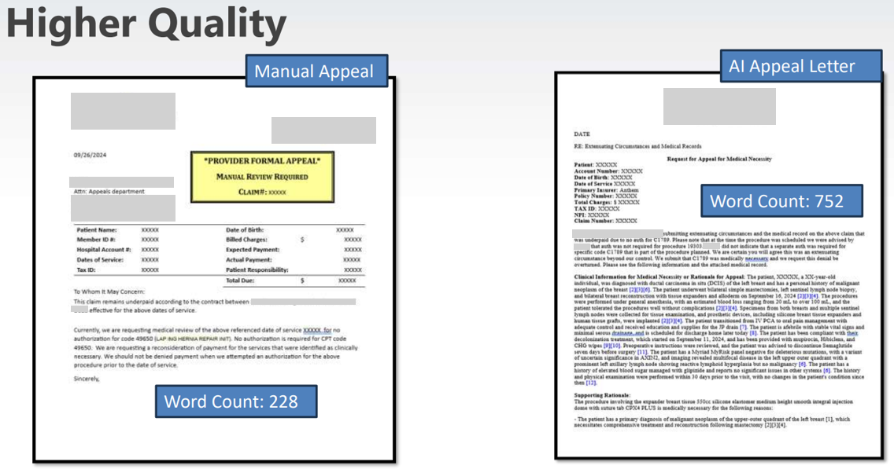
Organization Approach to AI Adoption
Rev Cycle
Prior Auth Management
LOS & Coding Tools
Medical Necessity Denials
Pilot began in April 2025 with AI-generated letters to payers for appeal of medical necessity denials

Slide 13
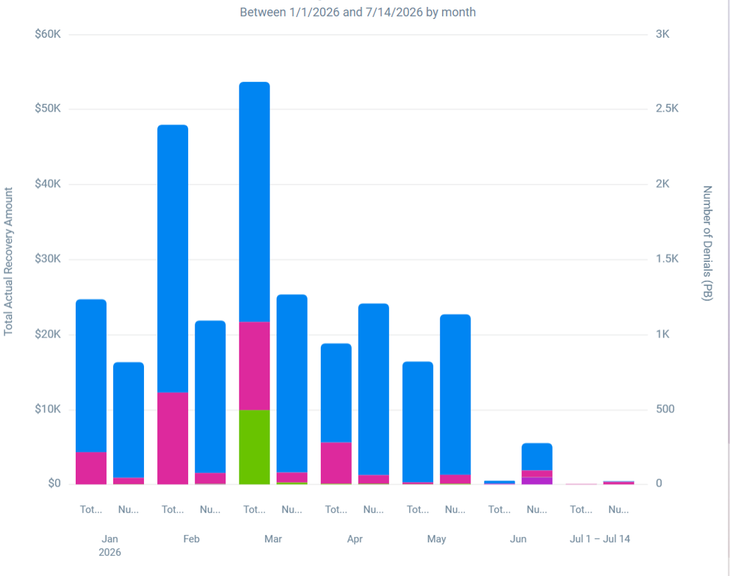
Organization Approach to AI Adoption
Rev Cycle
Prior Auth Management
LOS & Coding Tools
Medical Necessity Denials
Blue: AI generated an appeal
Pink: First AI-generated letter was successful
To date:
Approx 1K letters generated per month
Higher success rate than prior workflows on first pass
Saves approximately 1 hour per day for denials team members

Slide 14

Organization Approach to AI Adoption
End-users were often intimated by the vast amount of data within the EMR and not comfortable using the tools to create their own queries
AI-assistive tools are able to convert “casual language” questions and “hunches” into sophisticated Boolean logic queries
IT/Operations
Data Mining
Dashboard “insights”
Geodata Interfaces
Examples:
“How many of my diabetic patients with Medicare as their primary insurance with BMI > 27 have an A1c > 8.0, are not on a GLP-1, and have not seen me or an Endocrinologist in the last year”
“How many of Dr. Jones’s patients who had a heart cath in the last 5 years and are still living have either been to the ER for a primary diagnosis of chest pain or seen one of the APPs in the cardiology clinic on a day he had open slots on his schedule”

Slide 15
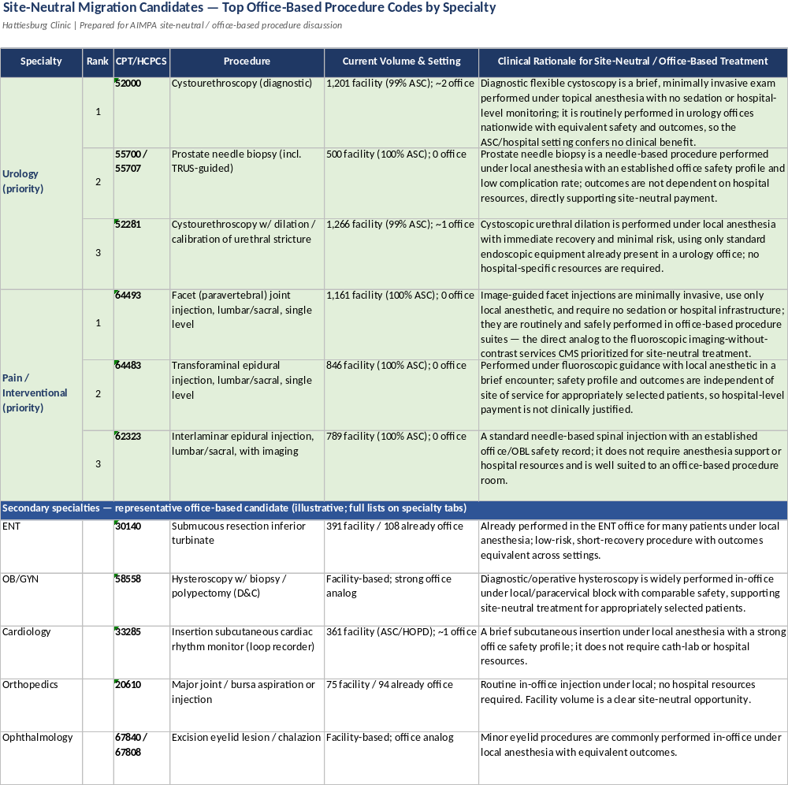
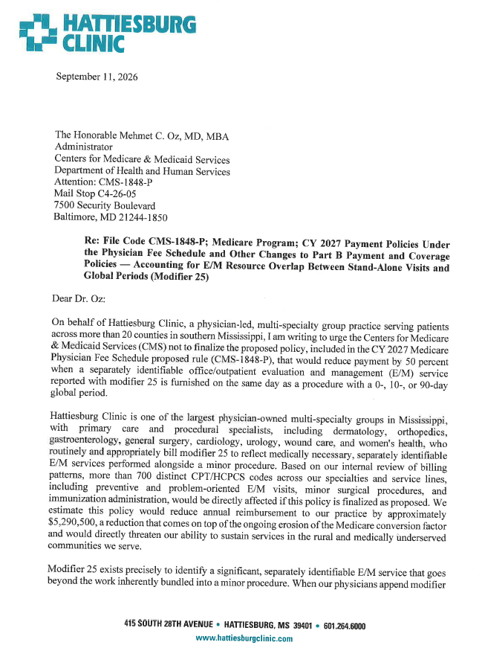
Organization Approach to AI Adoption
Scenario:
Site neutrality has been a focus of CMS over the last several years, and the proposed payment rules for 2027 make further adjustments
Many independent organizations would like to perform procedures in an outpatient setting that are still on the Inpatient Only List; furthermore, there are some procedures that are paid differently when performed as an office-based procedure
Analysis of all CPTs across all specialties, comparing them to fee schedule, and then the changes in a proposed rule would historically take days to weeks of dedicated time
IT/Operations
Data Mining
Dashboard “insights”
Cybersecurity Assistance

Slide 16
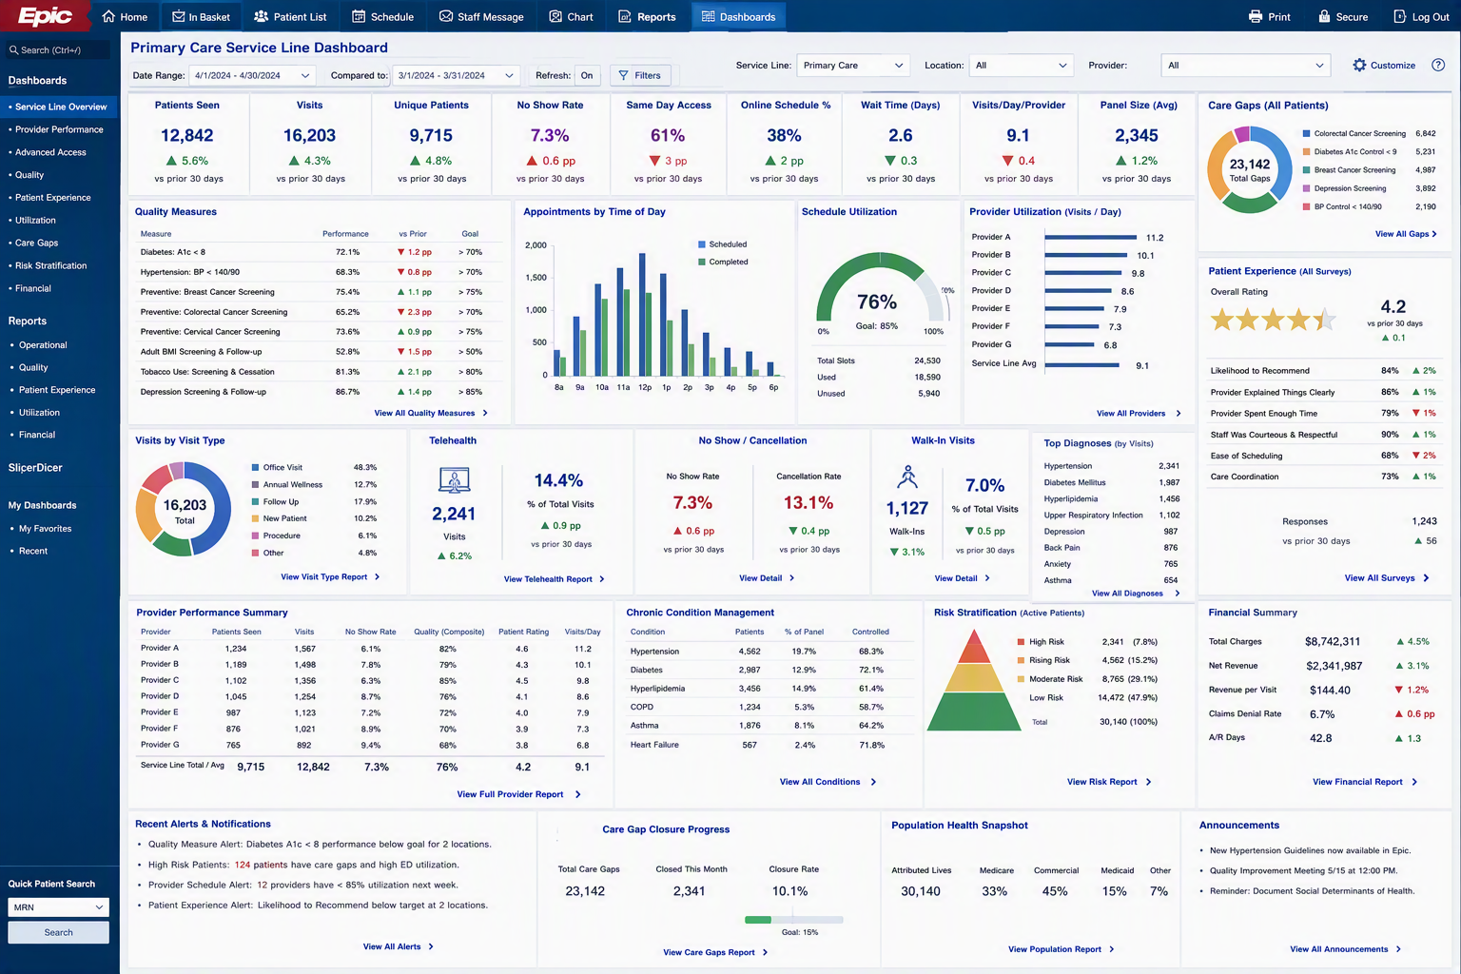
Organization Approach to AI Adoption
IT/Operations
Data Mining
Dashboard “insights”
Cybersecurity Assistance
* Image generated by AI

Slide 17
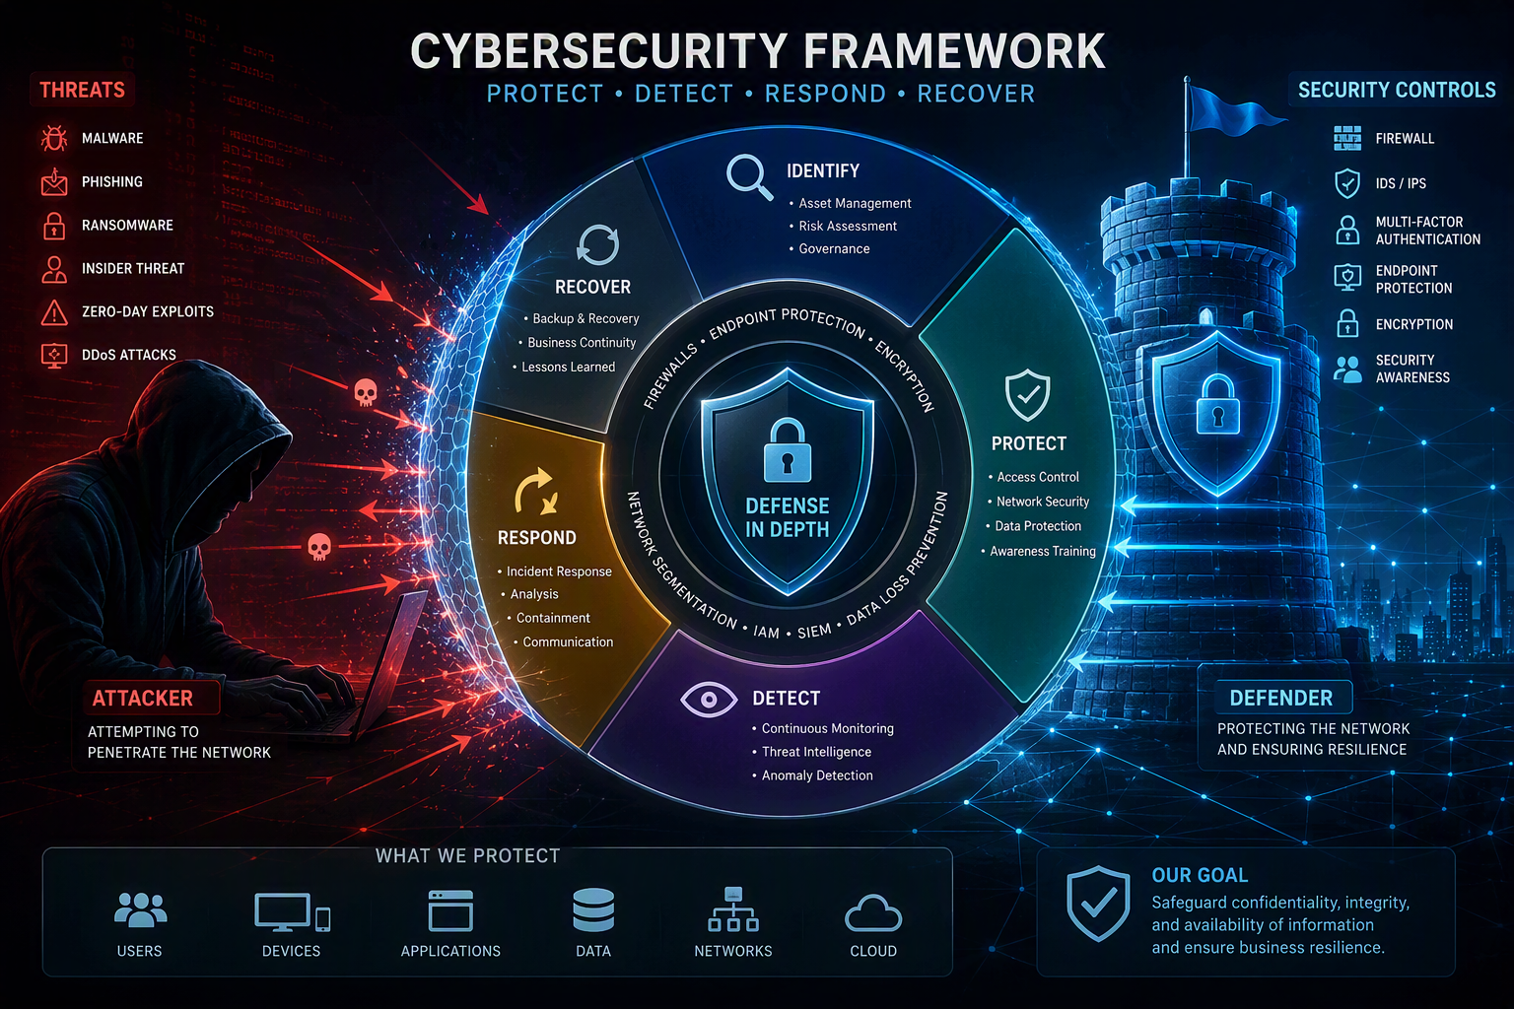
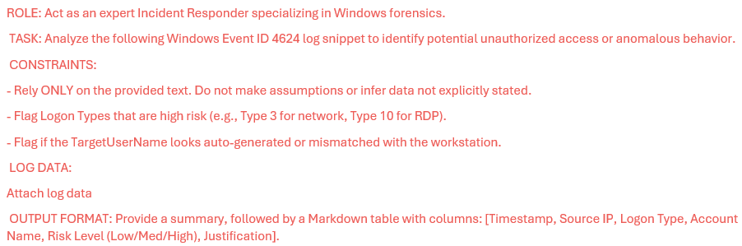
Organization Approach to AI Adoption
IT/Operations
Data Mining
Dashboard “insights”
Cybersecurity Assistance
Engaging AI to identify vulnerabilities in the network and provide mitigation suggestions

Slide 18
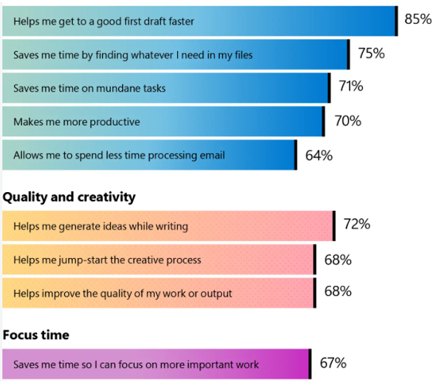
Organization Approach to AI Adoption
Objectively:
Meeting minutes completed more quickly, saving on average 15-20 minutes per meeting
Follow-up tasks are generated more completely
Email prioritization has been embraced by over 65% of users
Subjectively:
Admin
Meetings
Email Management
RHT Grant Applications

Slide 19
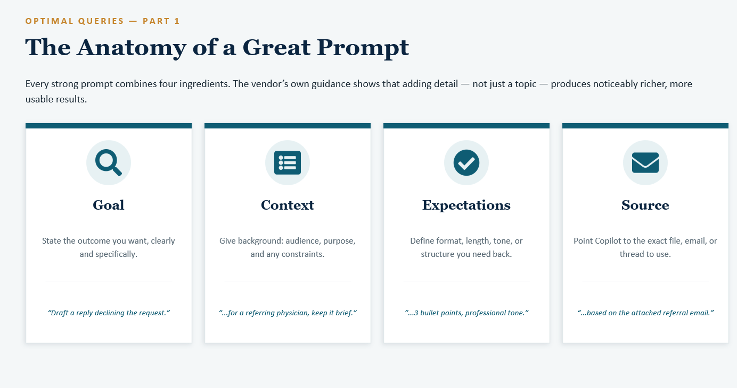
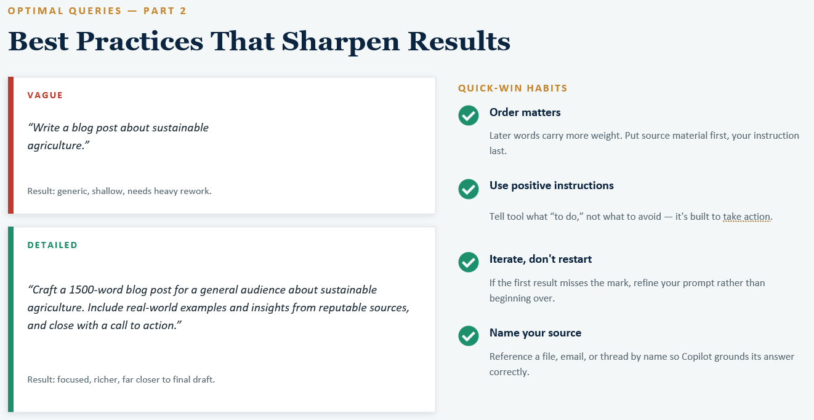
Organization Approach to AI Adoption
Admin
Meetings
Email Management
RHT Grant Applications
Excellent training by our IT team made available to all administrators.

Slide 20

Organization Approach to AI Adoption
Clinical
Ambient AI
InBasket Management
Summarization Tools
Rev Cycle
Prior Auth Management
LOS & Coding Tools
Medical Necessity Denials
IT/Operations
Data Mining
Dashboard “insights”
Geodata Interfaces
Admin
Lessons learned in widescale AI adoption projects across multiple areas:
Governance is crucial
Not all tools are created equal (we’ve had great success with some, and others have been less than inspiring)
Difficult to support multiple vendors, but no single vendor has all the solutions that we were hoping to implement
“Trust but Verify” isn’t cautious enough; these are not “plug and play” tools
Pathway to ROI isn’t what we’d originally envisioned
Future

Slide 21
Organization Approach to AI Adoption
Future
In pilot phase or on the horizon:
Epic’s “Ask Art”
AI Referral Insights
AI-suggested patient tasks
AI-assisted denial appeals beyond medical necessity
Orders integration with Ambient AI
Nursing documentation
Patient-facing pre-visit assistant
Patient-facing agentic scheduling assistant
  *we need to do a lot of schedule clean-up first
Billing office virtual assistants for patients (24-7-365)
“Intelligent Visits”
Augmented case management with agentic and AI-assistants
Build assistants for EMR and IT teams

Slide 22
Organization Approach to AI Adoption
Future
Refining our approach…
Initial Approach | Current Approach
Excitement-driven adoption decisions | Evidence-driven adoption decisions
Assume AI would rapidly automate work and reduce staffing needs | Assume AI will augment staff and improve productivity before it reduces staffing needs
Focus on technologies with the most impressive demonstrations | Focus on identifying technologies that solve a clearly-defined operational or clinical problem
Short, multiple pilot periods were expected to be sufficient for evaluation | Lengthy pilots with extensive validation, testing, review, redesign are required
Evaluation success primarily through FTE reduction | Evaluate success through productivity gains, time savings, improved quality, reduced burnout, and better user experience
Treat AI as a technology initiative | Treat AI as an organizational transformation involving people, workflows, data, education, and governance

