Slide 1

AI in Action: How an AI call center agent is opening the digital front door
Jessica Heestand MD
Practice President, Wake Internal Medicine Consultants, Inc.
IMGA September 2026

Slide 2



WIMC - WHO WE ARE
88 year old multi-specialty practice with two office locations in Raleigh, North Carolina
30 Physicians
10 Advanced Practice Providers
In-house ancillaries including lab, radiology, pathology, infusion suite
200 employees

Slide 3
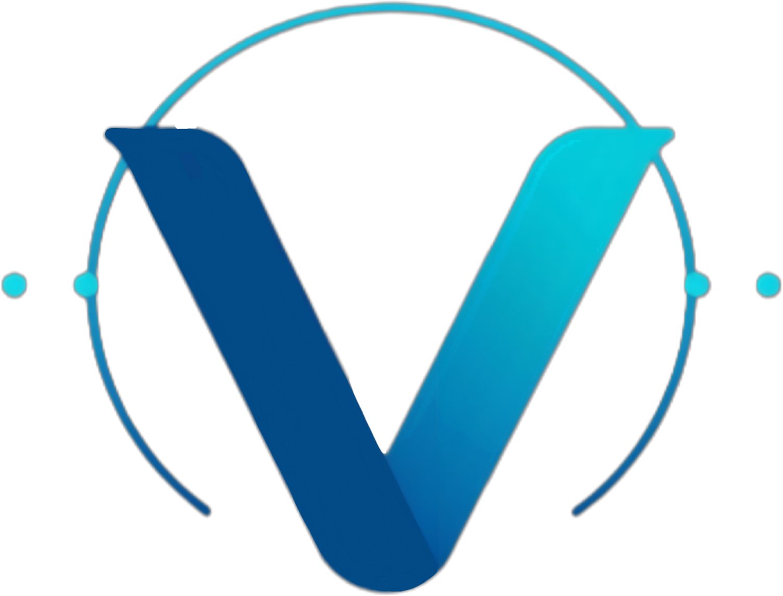
What We'll Cover Today
The Patient Access Crisis & AI Opportunity
01
How We Make it Work
02
WIMC Practice Performance — Q2 2026
03

Slide 4
The Access Crisis — and the AI Opportunity
Before a patient ever sees you, they have to reach you
85%
74%
20%
+5 min
won't call back after a failed first attempt
would switch providers after a poor phone experience
peak-hour call abandonment rate at busy practices
average hold time — double that at peak hours
The AI Aim — By the Numbers
Patient Experience
+20% call capacity
immediate increase after digital agent deployment
Health Equity
84% still book by phone
voice AI meets patients in their existing behavior
Per Capita Cost
~60% cost reduction
contact center operational savings; 5–10% appt. growth
Provider Well-Being
50% burden reduction
in contact center staff activity; +5% program growth
Population Health
40% 'Vulnerable Middle'
of panels are infrequent visitors; AI enables outreach
[1][2][3] Jolly, Johnson & Sethi. "Repurpose, Not Replace." MedCity News, May 2026 / MGMA & AJMC benchmarks | [4][5][9][11][12][14] Voxology AI internal data (2026), Phreesia 2020, NIH (2023)

Slide 5
Why Now ?
The demand-supply mismatch is structural and accelerating. Four implementation imperatives turn AI scheduling into lasting value.
DEMAND: RISING
SUPPLY: CONSTRAINED
1 in 4 Americans will be 65+ by 2060
85+ segment spends 8.5x more per capita than children
Chronic condition burden growing
~187,000 physician shortage projected by 2037
~208,000 RN shortage; 100,000+ RNs left in 2021 alone
Replacing one frontline employee costs 50–200% of salary
The Four Implementation Imperatives
01
Design for Your Actual Patients
02
Staff Alignment, Not Replacement
84% still book by phone — meet patients where they already are, not where a portal assumes them to be.
50% less contact-center burden frees staff to work top-of-license; framed as repurposing, not replacement.
03
Build an Active Feedback Loop
04
Technology as Friend, Not Foe
Deployment is the beginning — monitor call patterns, listen to staff, and iterate on workflow rules weekly.
Clear AI/human handoff rules — routine scheduling to AI, clinical judgment and escalations to staff — build trust.
[6][17] NTIA (2019) | [8][10][11][12][15] Voxology AI internal data / Jolly, R. CMU Business of Healthcare (April 2026)

Slide 6

Why now?
Phone volume on peak days reached 800 with 11 phone agents, resulting in significant mandatory overtime
High patient phone wait times
Inefficient schedule utilization

Slide 7

AI Solution
Increase practice capacity and operational efficiency
  Streamline onboarding new patients
  Increase access to scheduling with providers
Improve staff morale

Slide 8
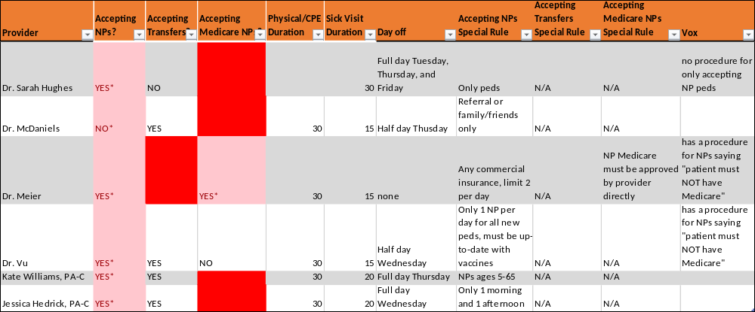


How we make it work
Rules turned into codes
  A complete 39 pages of rules that are translated into codes
  Multiple preferences of a multi-specialty practice with multiple providers

Slide 9
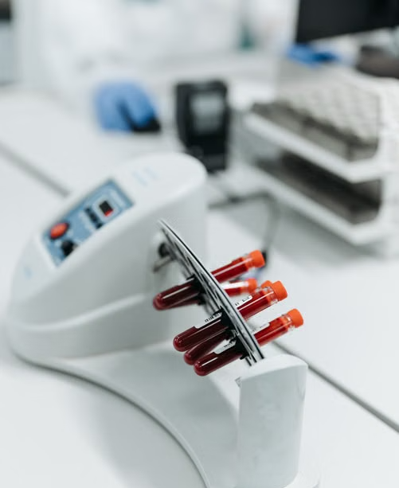

Scheduling Limitations
AI Phone Agent will not schedule visits for the following reasons:
  Emergency Care
  Diagnostic Testing
  Specialty Visits
  Procedures and Surgeries
  Telemed

Slide 10
Call Volume prior to and after Implementation

Slide 11
Missed Calls prior to and after Implementation

Slide 12
Triage
Highest volume category

Slide 13
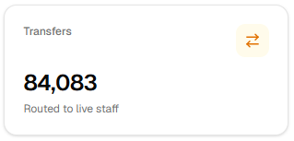

Reality with AI
Supplements our workforce, not replaces them (Jan-Jun 2026)

Slide 14
Continuous Improvement
Decreased wait times

Slide 15
Practice Performance — Q2 2026
April–June 2026 vs. 2025 | AI agent launched Jan 2026 | Wake Internal Medicine live deployment
43,485
27,632
10,703
36.5%
Total calls handled, Q2 2026
Staff calls handled, Q2 2026
Missed calls, Q2 2026
Avg. AI agent deflection rate
+32.7% YoY
–15.7% YoY
–20.4% YoY
NEW
Metric | April |  |  | May |  |  | June
 | 2025 | 2026 | Δ YoY | 2025 | 2026 | Δ YoY | 2025 | 2026 | Δ YoY
Total Calls Handled | 11,021 | 14,414 | +30.8% | 10,881 | 13,921 | +27.9% | 10,865 | 15,150 | +39.4%
Staff Calls Handled | 11,021 | 8,860 | –19.6% | 10,881 | 8,782 | –19.3% | 10,865 | 9,990 | –8.1%
AI agent Calls | — | 5,554 | NEW | — | 5,139 | NEW | — | 5,160 | NEW
Missed Calls | 5,431 | 3,400 | –37.4% | 4,192 | 3,649 | –13.0% | 3,821 | 3,654 | –4.4%
AI Deflection Rate | — | 38.5% | NEW | — | 36.9% | NEW | — | 34.1% | NEW
Next: activate the outbound agent to close care gaps (~40% of panel) and prevent referral leakage (25–50% industry standard).
Q2 2026 totals computed from the monthly table above | Staff = Celito front-desk agent calls (9 agents) | AI Deflection rate = Ai agent ÷ total calls

Slide 16
Additional Effects of AI
Successful introduction of new workflows

Slide 17


Addresses Problems
Closing care gaps through outreach campaigns to patients
Reduction of mandatory overtime per pay period for phone agents

Slide 18

Patient satisfaction
Positive
  Efficient
  Improved access
Areas of Improvement
  Present the option of call or text
  Introduce new workflows

Slide 19

Future plans for AI
Next step for WIMC for expanding AI utilization

Slide 20

Thank You + Questions
Jessica Heestand MD
jheestand@wakeinternalmedicine.com

